Slide 1
Queues & Implementation
CIS 200
Rafi Almhana
&
Robert Mann

Slide 2
Review of Stacks
What is a Stack?

Slide 3
Review of Stacks
What is a Stack?
Logical (or ADT) level: A stack is an ordered group of homogeneous items (elements), in which the removal and addition of stack items can take place only at the top of the stack.
A stack is a LIFO “last in, first out” structure.

Slide 4
Review of Stacks
What is a Stack?
Logical (or ADT) level: A stack is an ordered group of homogeneous items (elements), in which the removal and addition of stack items can take place only at the top of the stack.
A stack is a LIFO “last in, first out” structure.
What are the three primary functions needed to implement the Stack ADT?

Slide 5
Review of Stacks
What is a Stack?
Logical (or ADT) level: A stack is an ordered group of homogeneous items (elements), in which the removal and addition of stack items can take place only at the top of the stack.
A stack is a LIFO “last in, first out” structure.
What are the three primary functions needed to implement the Stack ADT?
void Push (ItemType newItem)
void Pop ()
ItemType Top () //or ItemType Peek()

Slide 6
Review of Stacks
What is a Stack?
Logical (or ADT) level: A stack is an ordered group of homogeneous items (elements), in which the removal and addition of stack items can take place only at the top of the stack.
A stack is a LIFO “last in, first out” structure.
What are the three primary functions needed to implement the Stack ADT?
void Push (ItemType newItem) -- Throws exception if stack is full; otherwise adds newItem to the top of the stack.
void Pop -- Throws exception if stack is empty; otherwise removes the item at the top of the stack.
ItemType Top -- Throws exception if stack is empty; otherwise returns a copy of the top item

Slide 7
What is a Queue?
Logical (or ADT) level: A queue is an ordered group of homogeneous items (elements),
in which new elements are added at one end (the rear), and elements are removed from the other end (the front).
A queue is a FIFO “first in, first out” structure.
Applications that involve waiting are frequently studied (simulated) using queues, to see how to reduce wait times.

Slide 8
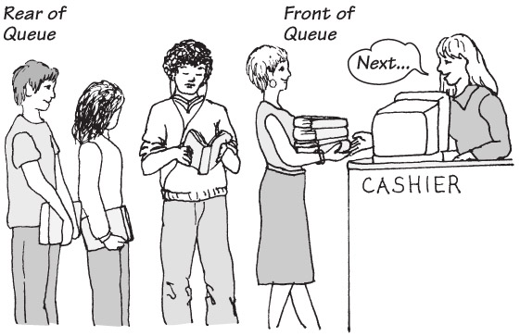
Example of a Queue

Slide 9
STL Queue
The Standard Template Library (STL) provides an implementation of Queue for us.
We will demo queues with the STL. However, it’s important to understand how queues work and not to just use a provide library.
Therefore, for most assignments and exams you should be comfortable with the members of the Queue ADT and how to implement them.

Slide 10
Queue ADT Operations
MakeEmpty -- Sets queue to an empty state.
IsEmpty -- Determines whether the queue is currently empty.
IsFull -- Determines whether the queue is currently full.
Enqueue (ItemType newItem) -- Adds newItem to the rear of the queue.
Dequeue (ItemType& item) -- Removes the item at the front of the queue and returns it in item.

Slide 11
ADT Queue Operations
Transformers
MakeEmpty
Enqueue
Dequeue
Observers
IsEmpty
IsFull
change state
observe state

Slide 12
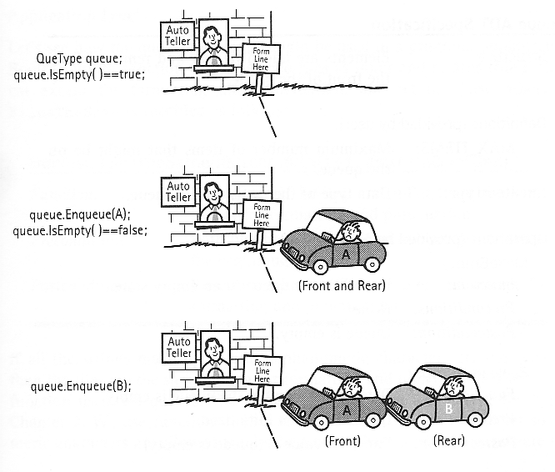
Queue ADT Operations

Slide 13
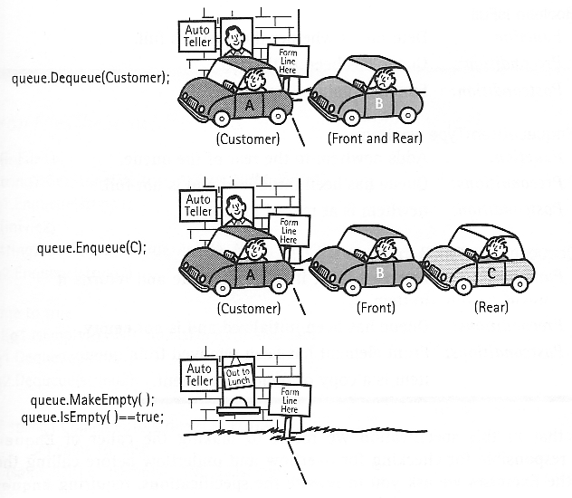
Queue ADT Operations

Slide 14
Implementation of Queue Operations
Stack
LIFO
Bottom is fixed
Top is changing
Queue
FIFO
Rear must be changing because of addition
Can the front be fixed ?

Slide 15
Implementation of Queue Operations
Stack
LIFO
Bottom is fixed
Top is changing
Queue
FIFO
Rear must be changing because of addition
Can the front be fixed ?
Array Implementation
Circular Array Implementation
Linked List Implementation
Circular Linked List Implementation

Slide 16
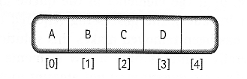
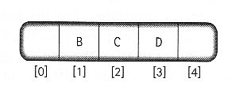

Array Based Implementation of Queue Operations
Enqueue(A), Enqueue(B), Enqueue(C), Enqueue(D)
Dequeue(item)

Slide 17
Implementation of Queue Operations
Enqueue operation the same as Push
Dequeue operation more complicated than Pop
MakeEmpty, IsEmpty, and IsFull operations the same as the equivalent stack operations

Slide 18
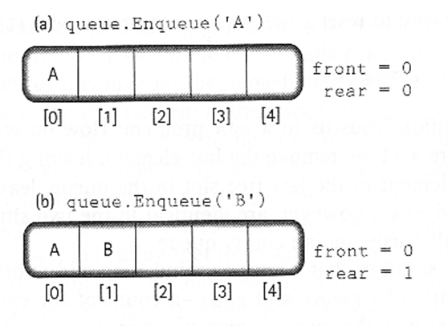
Another Queue Design: Circular Array Based Implementation
Let the both ends of queue float in the array

Slide 19
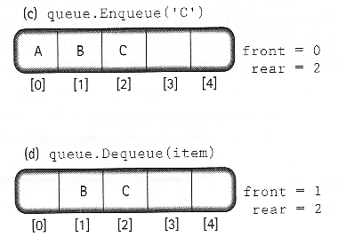
Circular Array Based Queue Design

Slide 20
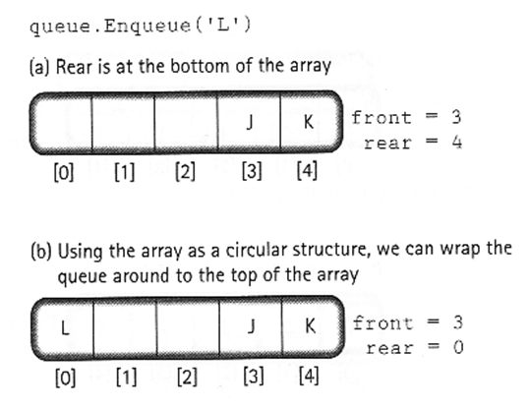
Circular Array Based Queue Design
Wrap around

Slide 21
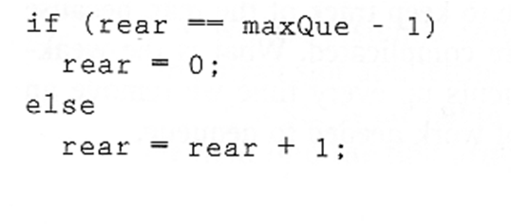
Circular Array Based Queue Design
Formula for Wrap-around
rear = (rear + 1) % maxQue

Slide 22
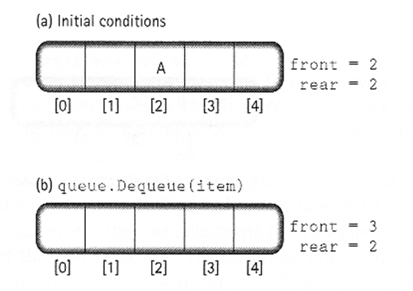
Circular Array Based Queue Design
an empty queue

Slide 23
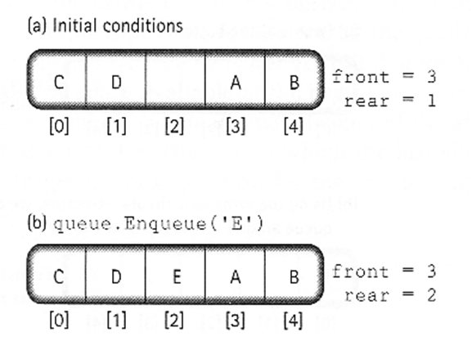
Circular Array Based Queue Design
a full queue

Slide 24
Circular Array Based Queue Design
How to distinguish an empty and full queue
Introduce another variable to count number of elements in the queue.
Let front indicate the index of the array slot preceding the front element in the queue.
Rear still indicates the index of the rear element in the queue.

Slide 25
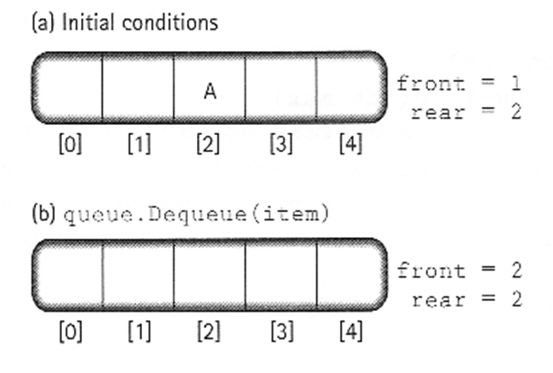
Circular Array Based Queue Design
Testing for an empty queue

Slide 26
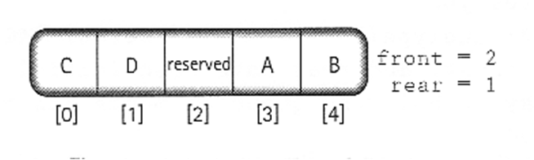
Circular Array Based Queue Design
Testing for a full queue
The element preceding the front of the queue is reserved.
We initialize front to maxQue – 1 and rear to front, i.e., maxQue – 1.

Slide 27
Public Interface of QueType
typedef char ItemType;
class QueType
{
public:
QueType(int max); // max is the size of the queue.
QueType(); // Default size of 500.
~QueType();
void MakeEmpty();
bool IsEmpty() const;
bool IsFull() const;
void Enqueue(ItemType item);
void Dequeue(ItemType& item);

Slide 28
SIMPLE ARRAY IMPLEMENTATION
class QueType
QueType
Private Data:
front 1
rear 4
maxQue 5
items
~QueType
Enqueue
Dequeue
.
.
.
‘C’‘X’ ‘J’
items [0] [1] [2] [3] [4]

Slide 29
CIRCULAR ARRAY IMPLEMENTATION
class QueType
QueType
Private Data:
front 1
rear 4
maxQue 4
items
~QueType
Enqueue
RESERVED
‘C’ ‘X’ ‘J’
Dequeue
.
.
.
items [0] [1] [2] [3] [4]

Slide 30
//--------------------------------------------------------
// CLASS TEMPLATE DEFINITION FOR CIRCULAR QUEUE
#include "ItemType.h" // for ItemType
template<class ItemType>
class QueType
{
public:
QueType( );
QueType( int max ); // PARAMETERIZED CONSTRUCTOR
~QueType( ) ; // DESTRUCTOR
. . .
bool IsFull( ) const;
void Enqueue( ItemType item );
void Dequeue( ItemType& item );
private:
int front;
int rear;
int maxQue;
ItemType* items; // DYNAMIC ARRAY IMPLEMENTATION };

Slide 31
//--------------------------------------------------------
// CLASS TEMPLATE DEFINITION FOR CIRCULAR QUEUE cont’d
//--------------------------------------------------------
QueType::QueType( int max ) // PARAMETERIZED
{
maxQue = max + 1;
front = maxQue - 1;
rear = maxQue - 1;
items = new ItemType[maxQue]; // dynamically allocates
}
bool QueType::IsEmpty( )
{
return ( rear == front )
}

Slide 32
//--------------------------------------------------------
// CLASS TEMPLATE DEFINITION FOR CIRCULAR QUEUE cont’d
//--------------------------------------------------------
QueType::~QueType( )
{
delete [ ] items; // deallocates array
}
bool QueType::IsFull( )
{ //WRAP AROUND
return ( (rear + 1) % maxQue == front )
}

Slide 33
//--------------------------------------------------------
// CLASS TEMPLATE DEFINITION FOR CIRCULAR QUEUE cont’d
//--------------------------------------------------------
void QueType::Enqueue( ItemType newItem )
// Post: newItem is at the rear of the queue
{
rear = (rear + 1) % maxQue;
items[rear] = newItem;
}
void QueType::Dequeue( ItemType &newItem )
// Post: The front of the queue has been removed and a copy returned in item
{
front = (front + 1) % maxQue;
newItem = items[front];
}

Slide 34
Linked List Based Class QueType
QueType
Private Data:
qFront
qRear
~QueType
‘C’
‘Z’ ‘T’
Enqueue
Dequeue
.
.
.

Slide 35
Not all tasks in a queue will have same priority
“All animals are equal, but some animals are more equal than others.” – Animal Farm

Slide 36
Priority Queue also stores priority of task
-remove splinter
-remove appendix
Which should have highest priority?
Request to ADT is for next task with highest priority

Slide 37
Priority Queue Operations:
isEmpty() return true if empty, false otherwise
enqueue() add new task to queue in order of priority; if equal priority to existing task then after that task
dequeue() remove task from queue with highest priority
peekFront() return next highest priority task, without removing from queue

Slide 38
Simulations:
Number of activities that can occur at once - how many cash registers are open?

Slide 39
Simulations:
Number of activities that can occur at once - how many cash registers are open?
How often do customers arrive?

Slide 40
Simulations:
Number of activities that can occur at once - how many cash registers are open?
How often do customers arrive?
How long do transactions take?

Slide 41
If data is modeled correctly, simulations can produce accurate predictions about performance.
predict average wait time
predict effect of hiring more cashiers, and how many and when (peak times)

Slide 42
Central to simulations is simulated time
Time 0 is the beginning of the simulation (ex. doors open)
Units of time should be what’s appropriate (seconds, minutes, hours)
Statistical information using probability theory is incorporated into model Used to generate events that reflect the real world.
Called event-driven simulation
Goal is to model long-term system behavior rather than predicting occurrence of specific events

Slide 43
Generating events to reflect the real world requires tremendous mathematical sophistication
For testing and evaluating various scenarios requires consistency
We presume we already have a series of events available in a file
Arrival time and duration, but NOT departure time
Having one input file allows testing of various configurations

Slide 44
TIME EVENT
20 Cus 1 enters, begins transaction (calculate depart after 6 minutes)
22 Cus 2 enters, joins queue
23 Cus 3 enters, joins queue
26 Cus 1 departs, Cus 2 begins transaction (calculate depart after 4 minutes)
30 Cus 2 departs, Cus 3 begins transaction (calculate depart after 2 minutes) Cus 4 enters, joins queue
32 Cus 3 departs, Cus 4 begins transaction (calculate depart after 3 minutes)
35 Cus 4 departs

Slide 45
TIME EVENT
20 Cus 1 enters, begins transaction (calculate depart after 6 minutes)
22 Cus 2 enters, joins queue
23 Cus 3 enters, joins queue
26 Cus 1 departs, Cus 2 begins transaction (calculate depart after 4 minutes)
30 Cus 2 departs, Cus 3 begins transaction (calculate depart after 2 minutes) Cus 4 enters, joins queue
32 Cus 3 departs, Cus 4 begins transaction (calculate depart after 3 minutes)
35 Cus 4 departs
Customer wait time is the elapsed time between arrival in the bank and start of the transaction

Slide 46
TIME EVENT
20 Cus 1 enters, begins transaction (calculate depart after 6 minutes)
22 Cus 2 enters, joins queue
23 Cus 3 enters, joins queue
26 Cus 1 departs, Cus 2 begins transaction (calculate depart after 4 minutes)
30 Cus 2 departs, Cus 3 begins transaction (calculate depart after 2 minutes) Cus 4 enters, joins queue
32 Cus 3 departs, Cus 4 begins transaction (calculate depart after 3 minutes)
35 Cus 4 departs
Customer wait time is the elapsed time between arrival in the bank and start of the transaction
Cus 1 wait time: 0 minutes
Cus 2 wait time: 4 minutes
Cus 3 wait time: 7 minutes
Cus 4 wait time: 2 minutes
average 3.25 minutes

Slide 47
This kind of simulation is concerned with
Arrival Events: customer arrives at the bank (externally generated event) no wait, go directly to teller wait, join back of queue
Departure Events: customer departs, task completed (internally generated event) (calculated by simulation)

Slide 48
Simulations must repeatedly determine times at which events occur and process them when they do occur.
In simulations and gaming, this is referred to as event loop

Slide 49
Simulation clock
time-driven simulation
determine arrival and departure times at random and compare to clock
increment clock by 1 to simulate time passing
event-driven simulation
file contains arrival times and transaction times
no actions required between events so clock jumps
keep an event queue
contains all arrival and departure events that WILL happen stored in ascending order so next event is on top
ordered by priority, so priority queue challenge is managing event queue

Slide 50
Event-driven requires two queue entries (and possibly multiple queues)
1. event starts
2. creates a departure event, which is inserted into queue

Slide 51
pseudo-code for arrival event:
//update event queue
remove arrival event for customer from event queue
//update bank line
if (bank line is empty and teller is available)
calculate depart time as current time + transaction length
add departure event for customer to event queue
mark teller as unavailable
else
add customer to bank line

Slide 52
pseudo-code for departure event:
//update event queue
remove departure event from event queue
//update bank line
if (bank line is not empty)
remove customer from front of bank line
Customer begins transaction
departure time is current time + transaction time
add departure event for customer to event queue
else
mark teller as available

Slide 53
pseudo-code event-driven simulation:
//requires bank line queue and priority queue
//create and add arrivals to event priority queue
while ( data file is not empty )
get next arrival time and transaction time from file
enter new event into priority queue
//event loop
while (priority queue is not empty)
remove event from priority queue
get current time
if event is arrival event
process arrival
else
process departure

Slide 54
pseudo-code event-driven simulation:
//process arrival
remove event from priority queue
if bank line is empty && teller is available
calculate departure time
create departure event
add departure event to priority queue
teller is not available
else
add customer to bank line

Slide 55
pseudo-code event-driven simulation:
//process departure
remove event from priority queue
if bank line is empty
teller is available
else
get next person from bank line
calculate departure time
create departure event
add departure event to priority queue

Slide 56
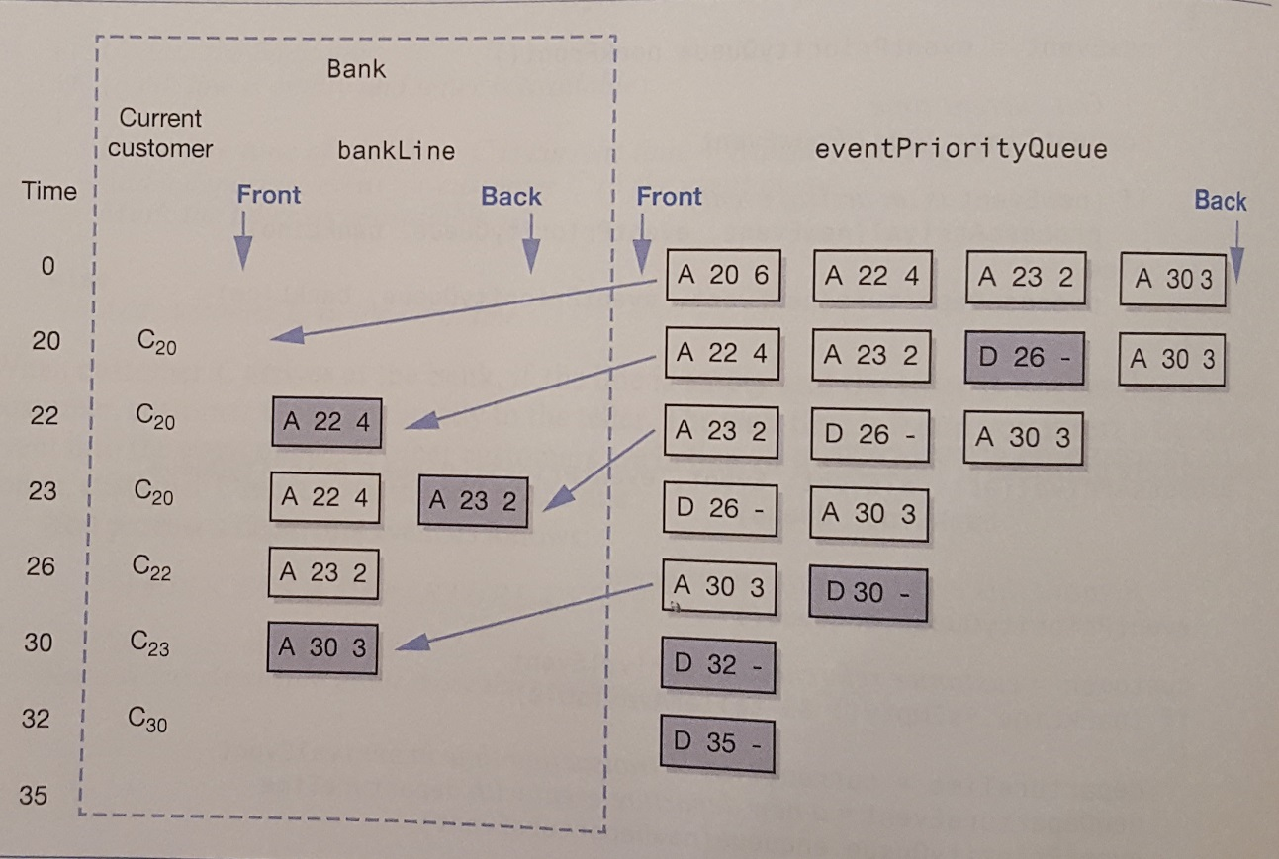
Trace of bank simulation (figure 13-8)
A is arrival
D is departure
Blue boxes are events that change/created at each point in time.

Slide 57
ADT’s are classified as position oriented or value oriented
Position-oriented ADT organizes items according to positions
Value-oriented ADT organizes items by their values

Slide 58
ADT’s are classified as position oriented or value oriented
Position-oriented ADT organizes items according to positions
stack
queue
list
Value-oriented ADT organizes items by their values
sorted list
priority queue
Bag does not order entries so neither value nor position oriented

